Slide 1
Pressure Measurements
K. Poddar

Slide 2
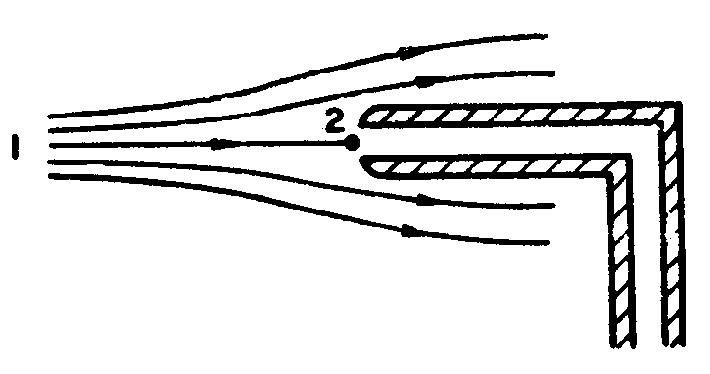
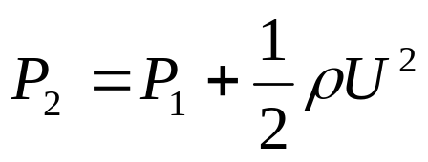
Total Pressure
The total pressure is defined as the pressure obtained by isentropically decelerating the flow to rest.
A fluid particle moving towards the nose of the Pitot
Tube is brought to rest at the nose if the tube is not
bleeding fluid.
A manometer connected to the
Pitot tube will measure the total
pressure P₂
Pitot Probe
NWTF (IITK)

Slide 3
Total Pressure
The main parameters influencing the total
pressure Measurements are:
    Incidence
    Velocity gradient
    Proximity of wall
    Flow unsteadiness
    Probe geometry
    Reynolds number
    Mach number
NWTF (IITK)

Slide 4
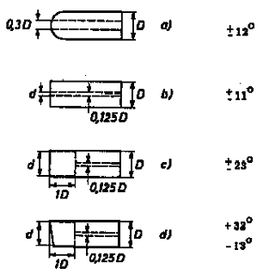
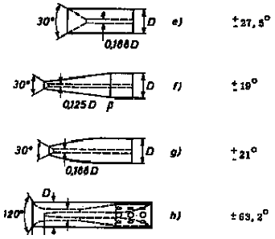
Incidence Effect
Pitot tubes are not very sensitive to angle of attack.
NWTF (IITK)

Slide 5
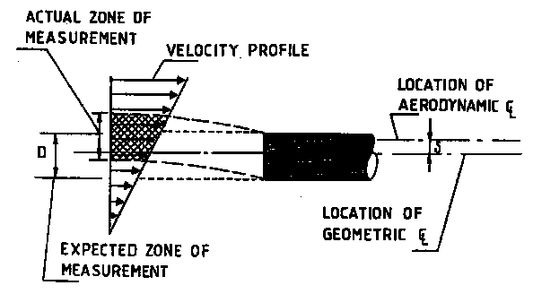
Velocity Gradient Effect
The presence of a probe in a velocity gradient causes
deflection of the streamlines towards the region of lower
Velocity. Thus causing the probe to indicate total pressure
in excess of the one existing at the probe location. The
Deflection of the streamlines could be as much as 0.15D.
NWTF (IITK)

Slide 6
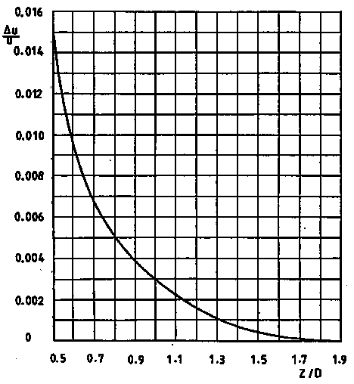
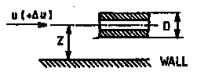
Wall Proximity Effect
Because of the deflection
of streamlines near the wall
Pitot tube will read slightly
higher pressure.
NWTF (IITK)

Slide 7
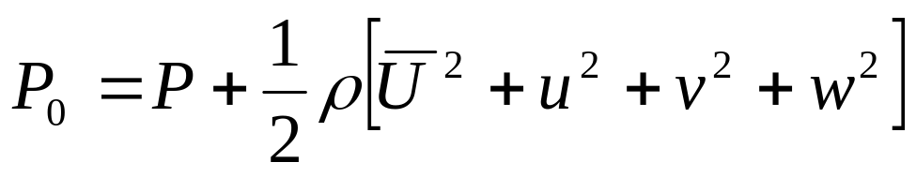
Turbulence Effect
Turbulence may influence Pitot tube reading in two ways:
  The fluctuating velocity component influences the
  direction of the flow approaching the orifice.
  The fluctuating velocity component may contribute
  to the stagnation pressure.
Typically, turbulence contribution is less than 2%
NWTF (IITK)

Slide 8
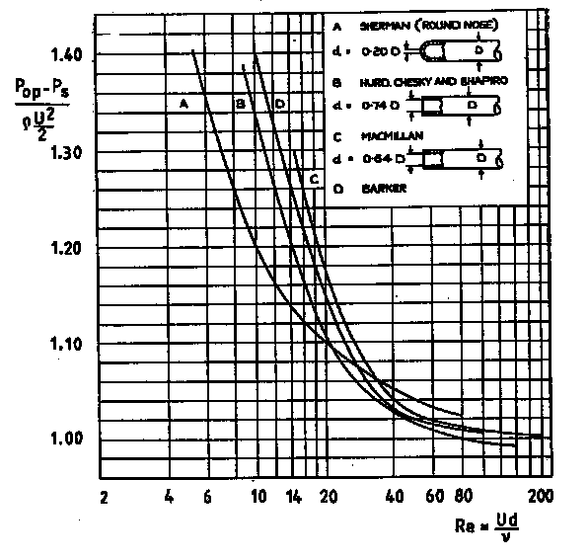
Effect of Re
For Re < 100,
Reynolds number
effect is significant.
NWTF (IITK)

Slide 9
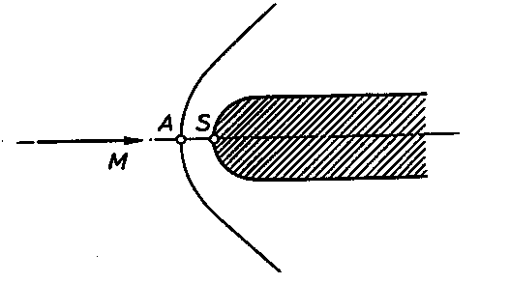
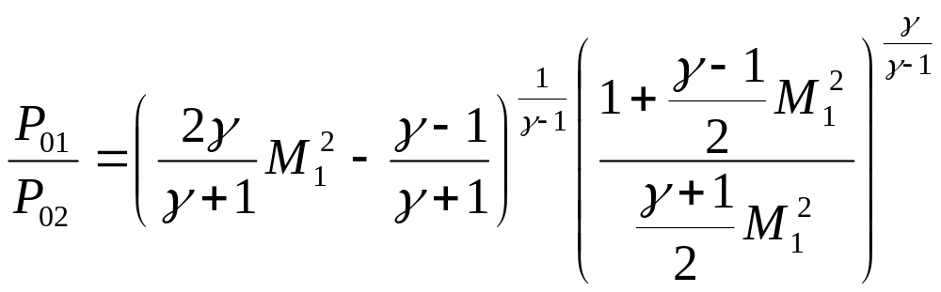
Effect of Mach Number
A Mach number variation does not substantially affect
the pitot tube pressure measurement if the flow is
subsonic. However, in supersonic Mach numbers, a
pitot tube does not indicate the local total pressure
since a detached shock wave stands ahead of the
probe.
NWTF (IITK)

Slide 10
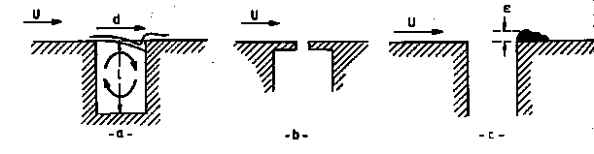
Static Pressure
Wall static pressure measurement
NWTF (IITK)

Slide 11
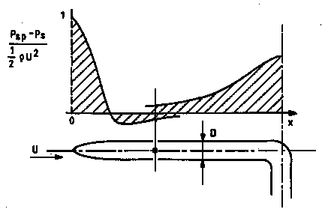
Static Pressure tube
Effect of nose: accelerates the flow; pressure decreases.
Effect of stem: retards the flow; pressure increases.
NWTF (IITK)

Slide 12
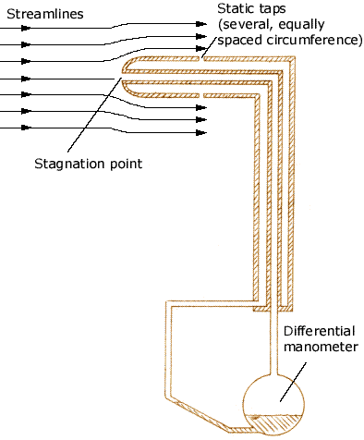
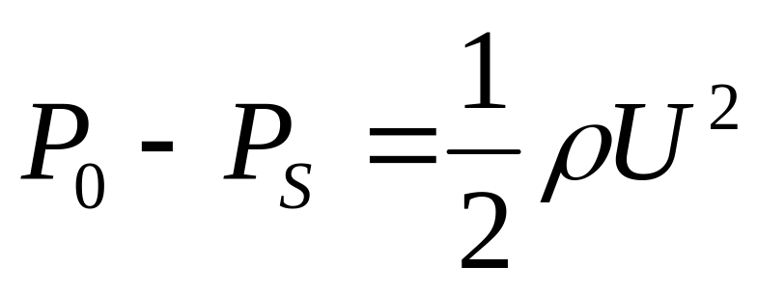
Total Pressure
NWTF (IITK)

Slide 13
Pressure Transducers
Passive devices: an electrical circuit element (R, L, C)
is modified by the physical effect. This change in
electrical properties is sensed by a voltage device.
  -- Variable resistance transducers
  -- Variable capacitance transducers
  -- Variable inductance transducers
  -- Variable reluctance transducers
Active devices: the physical effect produces an
electrical voltage.
-- Piezo-electric transducers
NWTF (IITK)

Slide 14
Pressure Transducers
Pressure transducers can be classified according to the
type of pressure measured:
Gauge pressure transducer
Absolute pressure transducer
Differential pressure transducer
Sealed pressure transducer
NWTF (IITK)

Slide 15
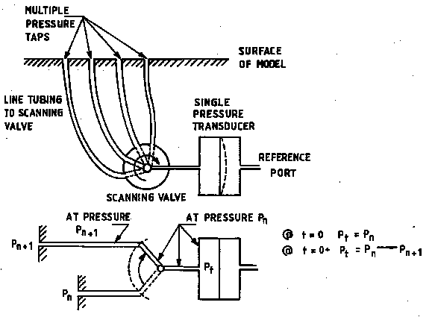
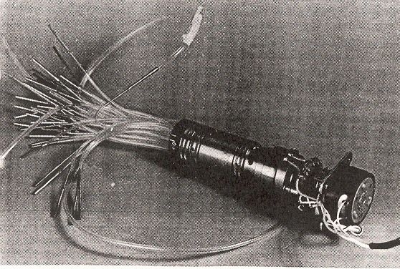
Scanning Valve
Pressure from multiple taps
are fed to a transducer one
at a time by using the scan-
ning valve.
NWTF (IITK)

Slide 16
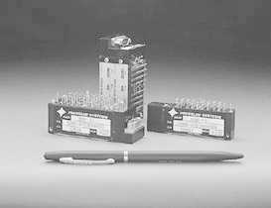
Electronic Pressure Scanners
This consists of a number of individual pressure transducers,
assembled together in a module of 16, 32, or 64, each
Transducer port is connected to a tap where pressure has to
be measured.
NWTF (IITK)

